Slide 1

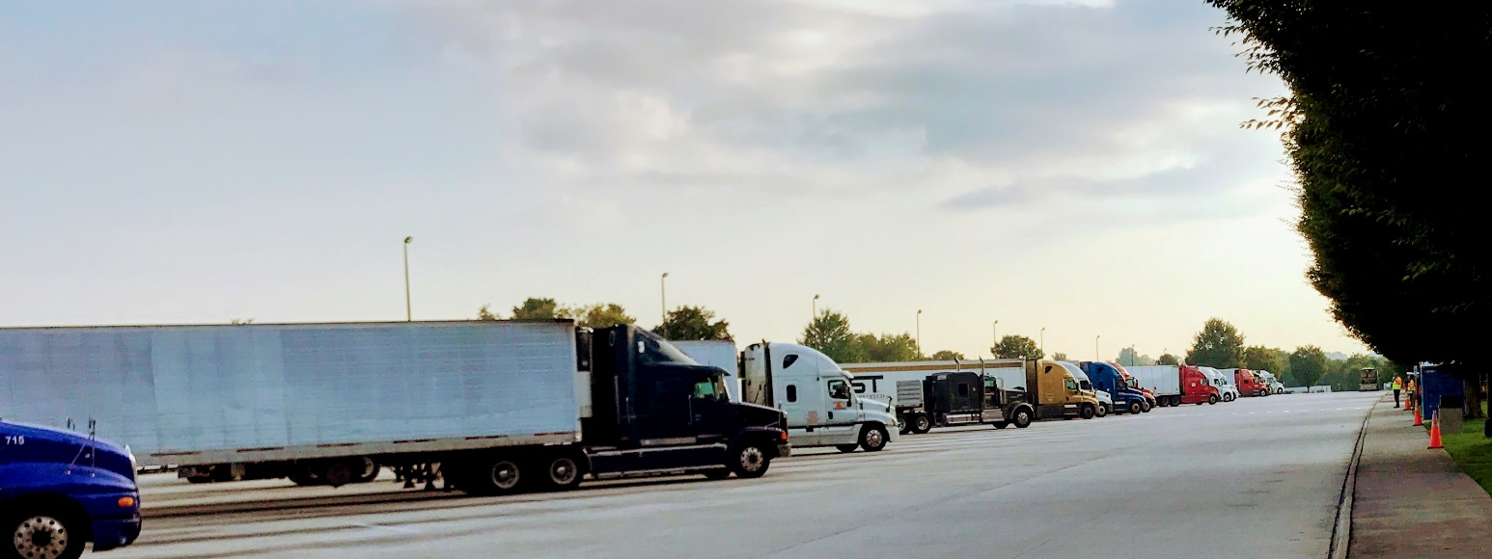
TRUCK PARKING INFORMATION
Atizaz Ali, ITS/Traffic Engineer (HNTB Corp.) & fill_in_details
July 17, 2018
Arlington, VA

Slide 2
Problem Statement
Provide real-time information on available parking
Illegal parking
Compliance with Hours of Service (HOS) rules
Increase utilization of public truck parking spaces
Reduce the time truck drivers take searching for available safe, legal parking spaces
Improve roadway safety

Slide 3
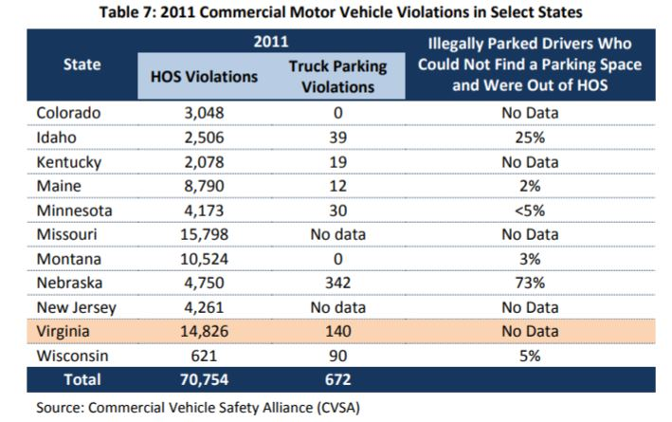
Source:
Commercial Vehicle Safety Alliance (CVSA)

Slide 4
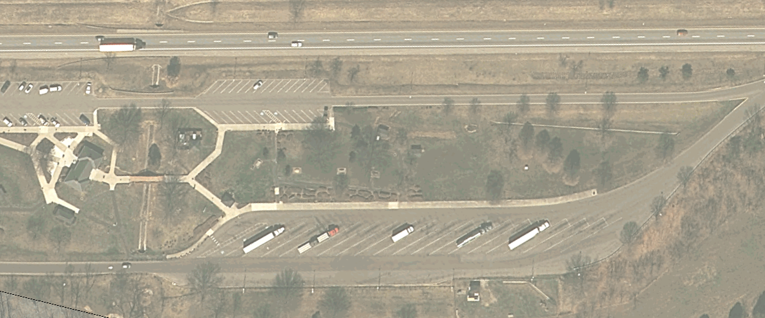
Ironto Rest Area NB
Notes:
The problem – illegal parking on shoulder

Slide 5
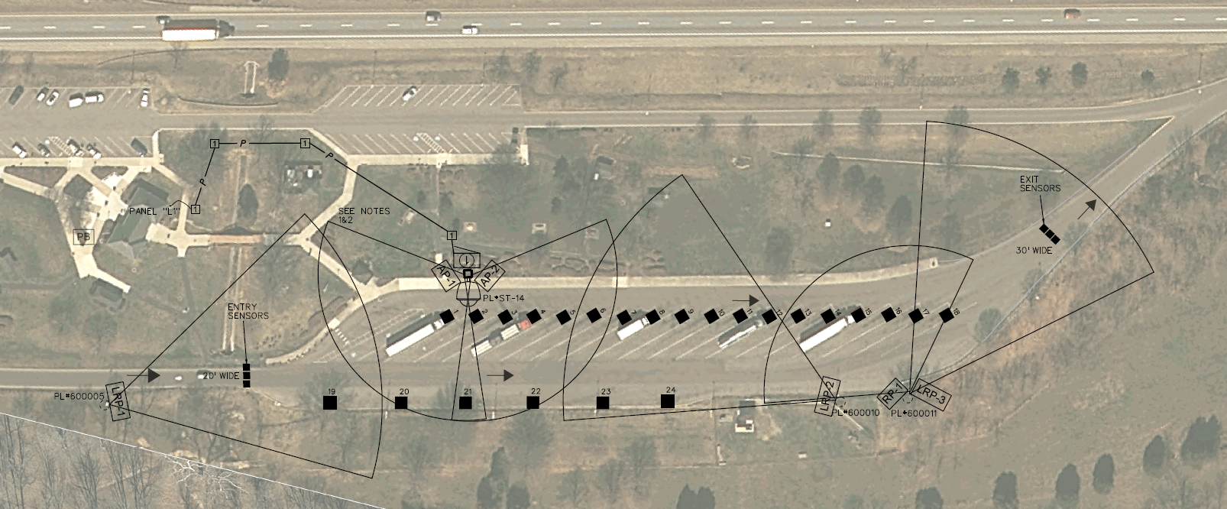
Sample Design: Ironto Rest Area NB

Slide 6
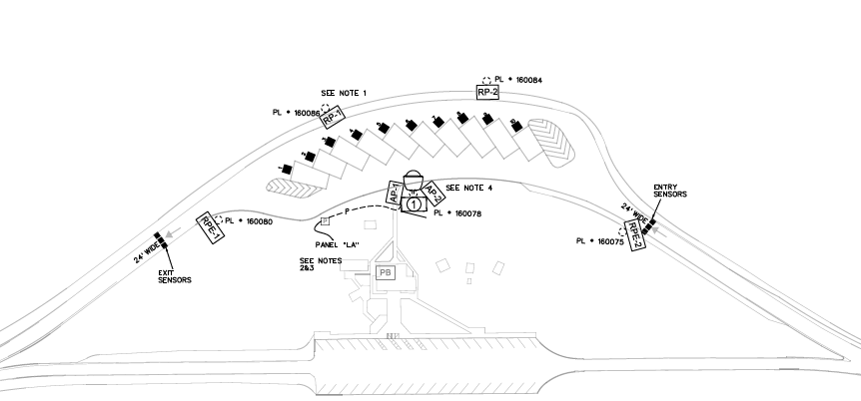
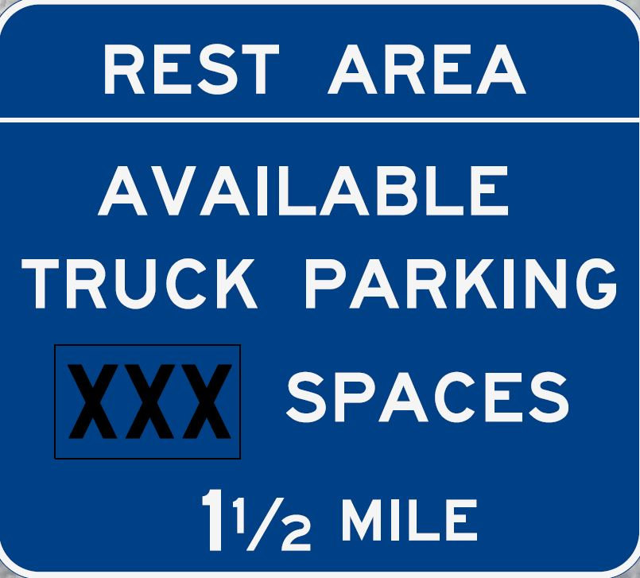

CENTRAL
SERVER
07
08

Slide 7
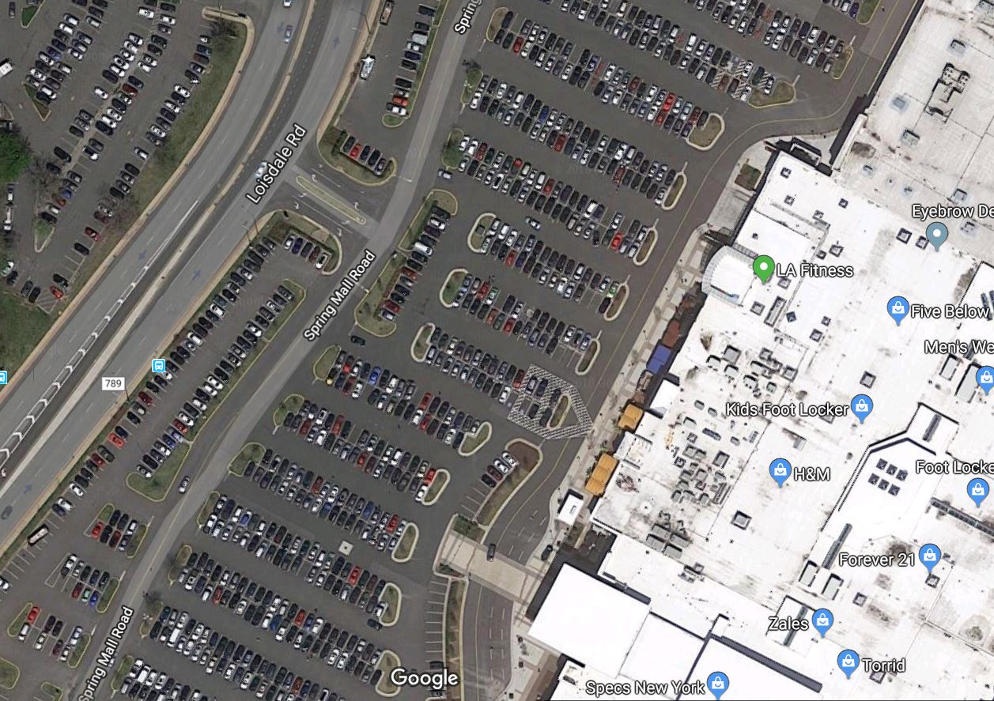
The Challenge

Slide 8
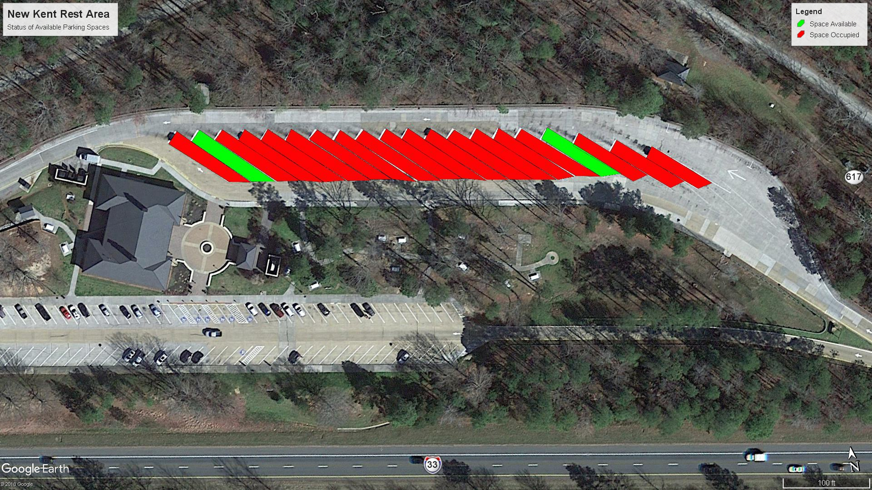
Individual Parking Space Occupancy

Slide 9
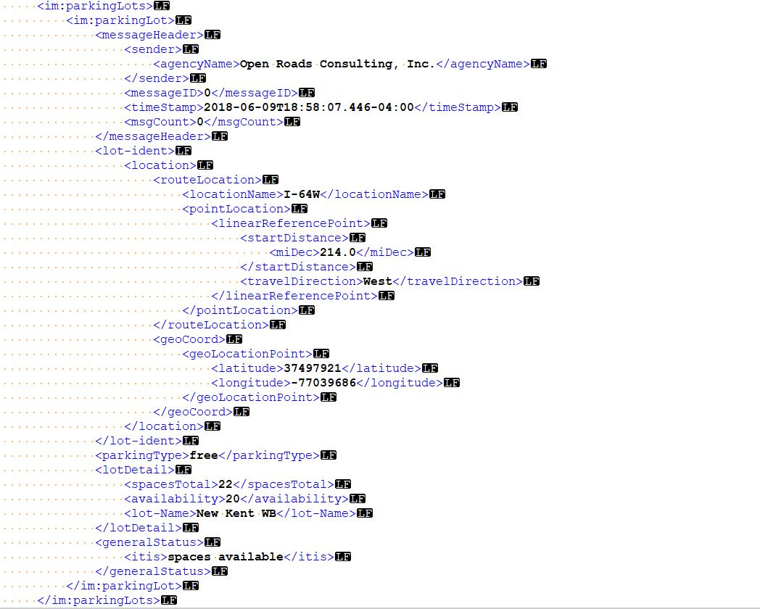
Truck Parking Feed: Attributes
Rest Area Name
Rest Area Location
Total Parking Spaces
Spaces Available
Location of Rest Area
General Status
Timestamp (last update)
Mile Marker

Slide 10
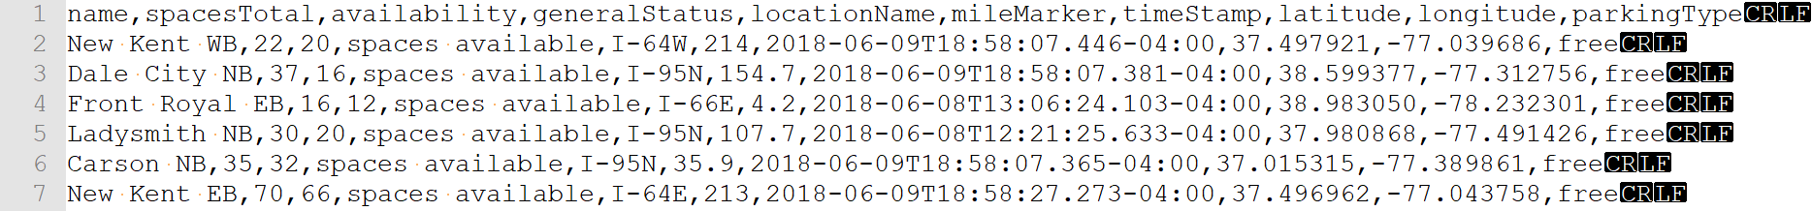
Parsed Data

Slide 11
Interactive Map

Slide 12
Benefits
Safety
Knowledge of space availability (reduce time spent searching for safe and legal parking)
Improve freight delivery and reliability
Maximize use of existing infrastructure
Travel time savings
Facilitates truck drivers decision-making and trip planning

Slide 13
Conclusion/Future Prospects

